Slide 1
Residual Stresses in Deposited Thin-Film Material Layers for IC Manufacturing
Undergraduate Fellows: Dennis Binford, Matthew Heilig, Henry Baxter, Gavin Cervantez
Samsung Austin Semiconductor Fellowship
Research Fall 2024
Advisor: Dr. Jun Zou

Slide 2
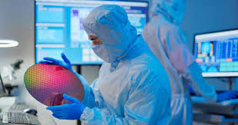
Introduction & Outline
Importance of residual stress in IC manufacturing
Residual stress measurement methods and results
Methods to manage and mitigate residual stress
Milestones achieved and future plans

Slide 3
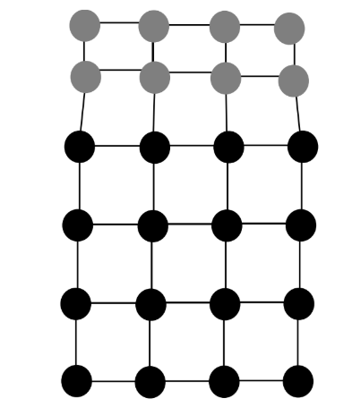
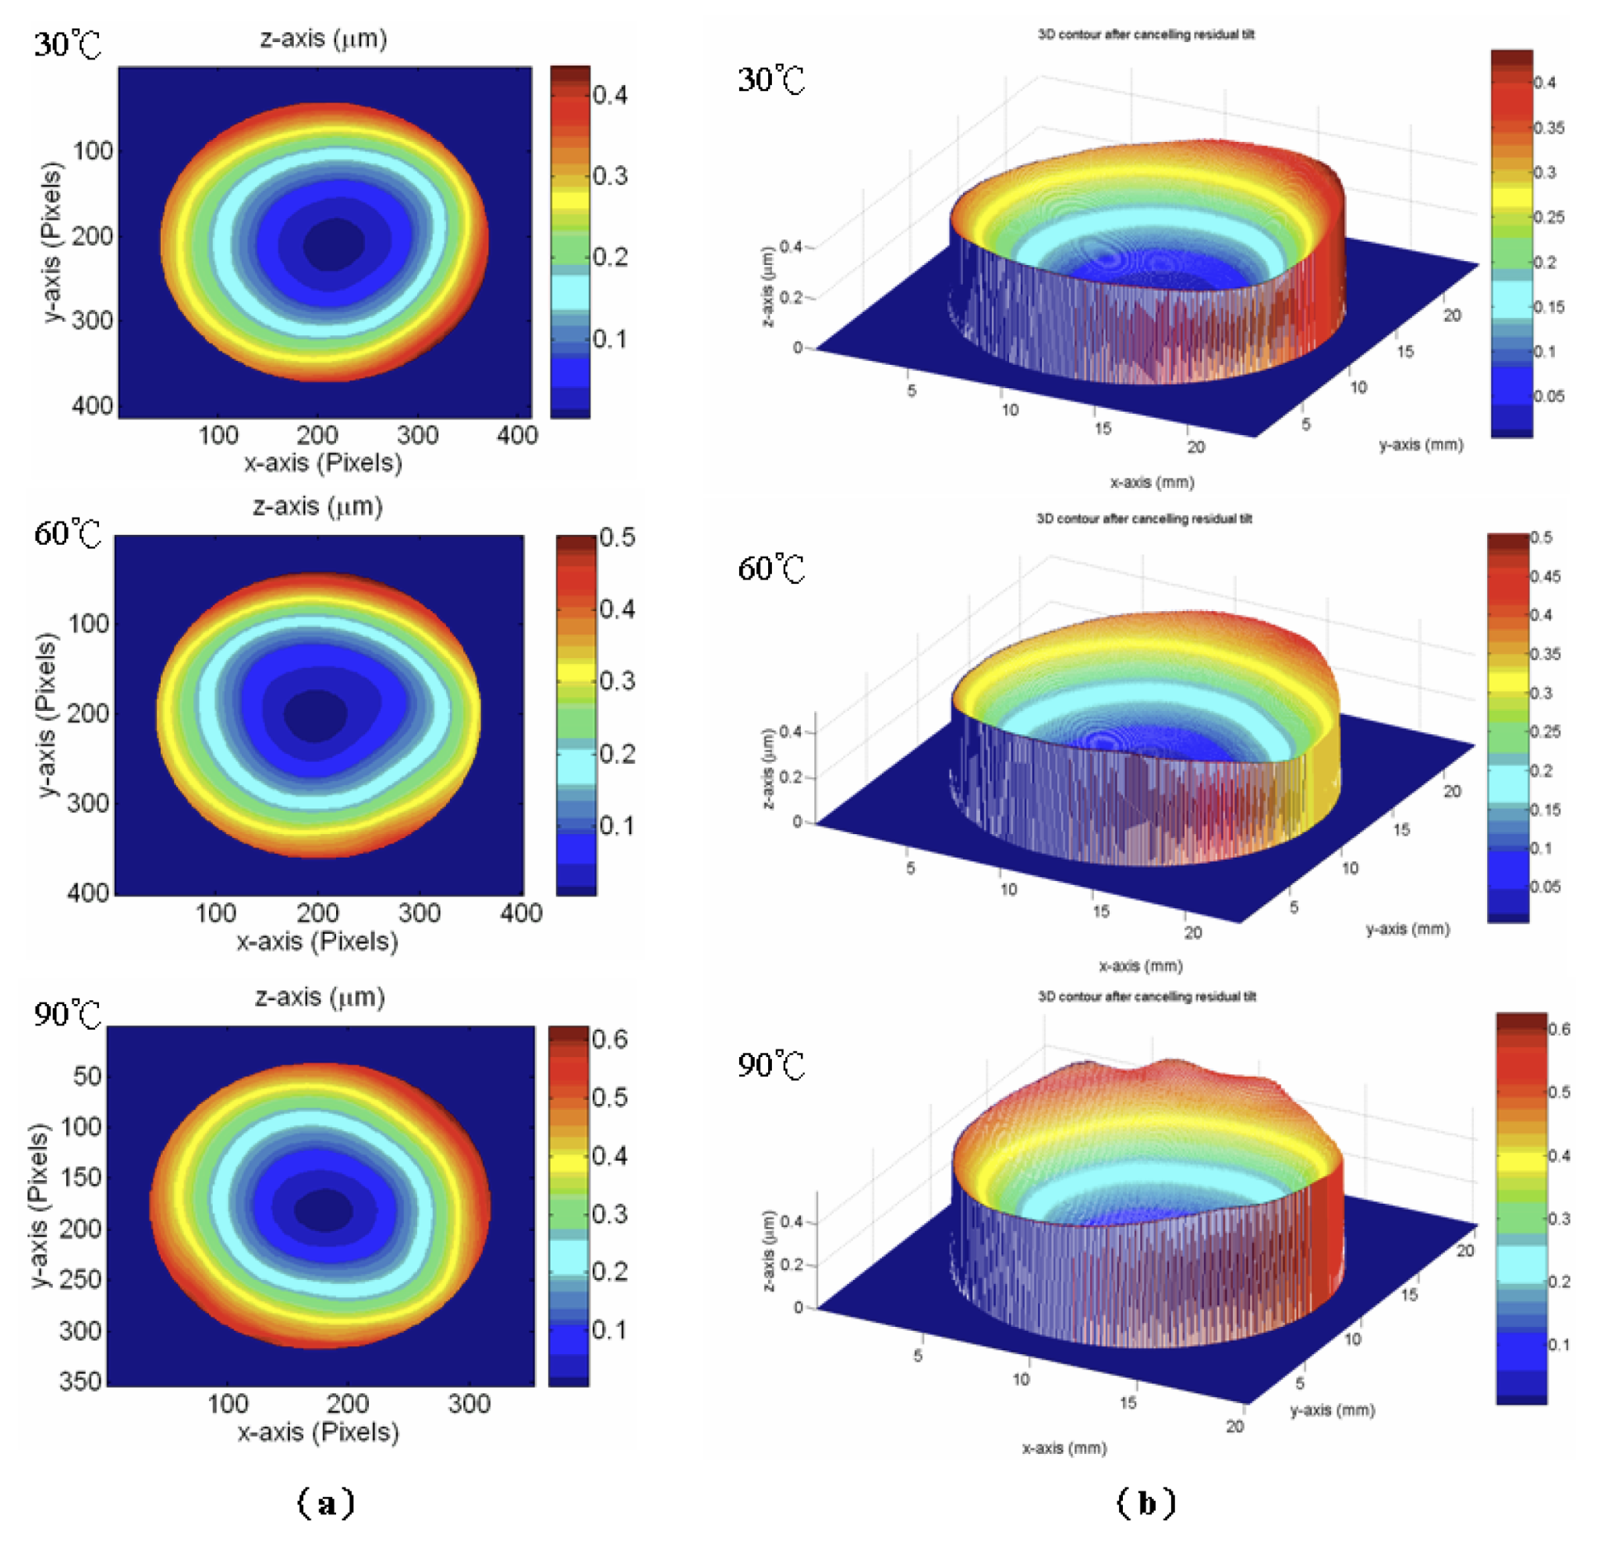
Importance of Residual Stress in IC Manufacturing
Intrinsic Stresses
  Caused by deposition process conditions (e.g., lattice mismatch, grain boundaries)
Extrinsic Stresses:
  Arise from environmental factors (e.g., thermal expansion mismatch)
Impact on Device Performance
  Altered mechanical stiffness
  Device failures like cracking, buckling, or delamination
  Strain engineering for device performance improvement
Notes:
Include some Figures here; Cooling of a thin-film on a substrate with a different thermal expansion coefficient

Slide 4
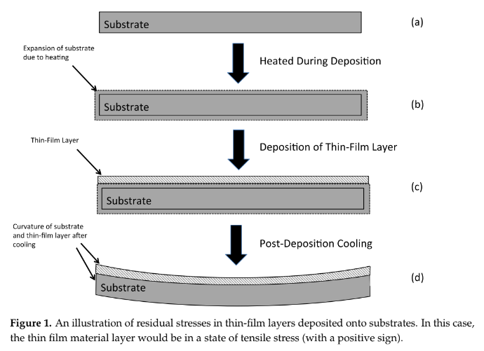
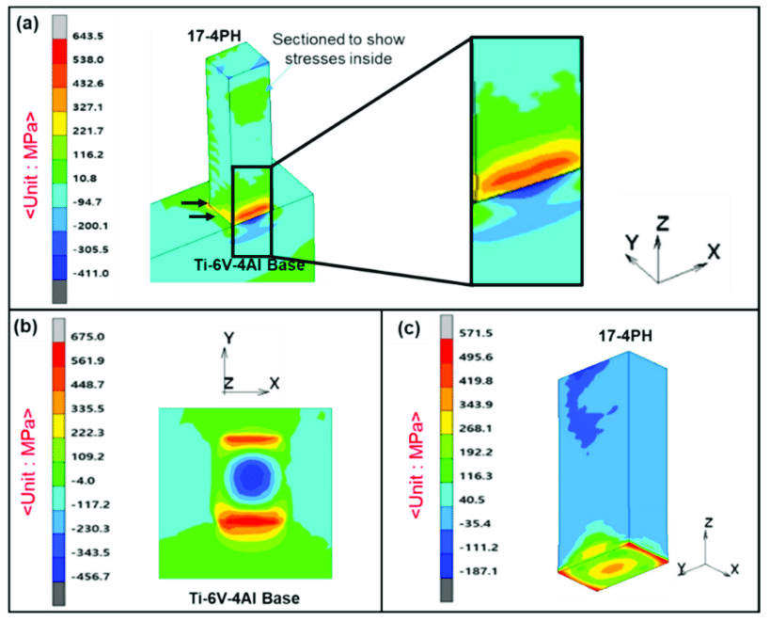
Residual Stress Measurement Methods
Wafer Curvature Measurement
  Stoney equation for calculating stress from curvature
Test Structures
  Buckling beams, Guckel rings, and strain-based tests

Slide 5
Residual Stress Level in Typical Thin-Films for Semiconductor Fabrication
Material | Chemical Vapor Deposition | Physical Vapor Deposition
Polysilicon | LPCVD: -340 to 1750 MPa | N/A
Amorphous Silicon | PECVD: -575 to -130 MPa | Evaporation: 300 MPa Sputter: -22 to 164 MPa
SiO | LPCVD: -10 to 200 MPa PECVD: -80 to -25 MPa | Sputter: -90 to 3000 MPa
SiN | LPCVD: 967 to 1020 MPa PECVD: -250 to 375 MPa | N/A
Metals | N/A | Evaporation: Varied
Takeaways | High residual stress variability | Lower temperature process with lower stress
Notes:
For nearly all film application processes, the substrate must be heated for deposition.
This causes thermal expansion for both the wafer and the film, and if the thermal expansion is not the same between the two, it causes strain when the materials contract due to cooling
Another source is the difference in crystal size between the wafer and the film. At the boundary between the matrix and new growth, the crystal lattices have to align somewhat for the new material to be deposited. When a crystal with another lattice length is deposited onto a matrix, it becomes either stretched or compressed to fit the same shape as the matrix. This is another source of residual stress
SiO- Silicon monoxide
SiN- Silicon nitride
LPCVD: Low-Pressure Chemical Vapor Deposition
PECVD: Plasma-Enhanced Chemical Vapor Deposition
MPa: Mega pascales
CVD: High residual stress variability due to temperature and gas flow; Can be tensile or compressive, from tens to hundreds of MPa
PVD: Lower temperature processes with precise material control allows for lower residual stress

Slide 6
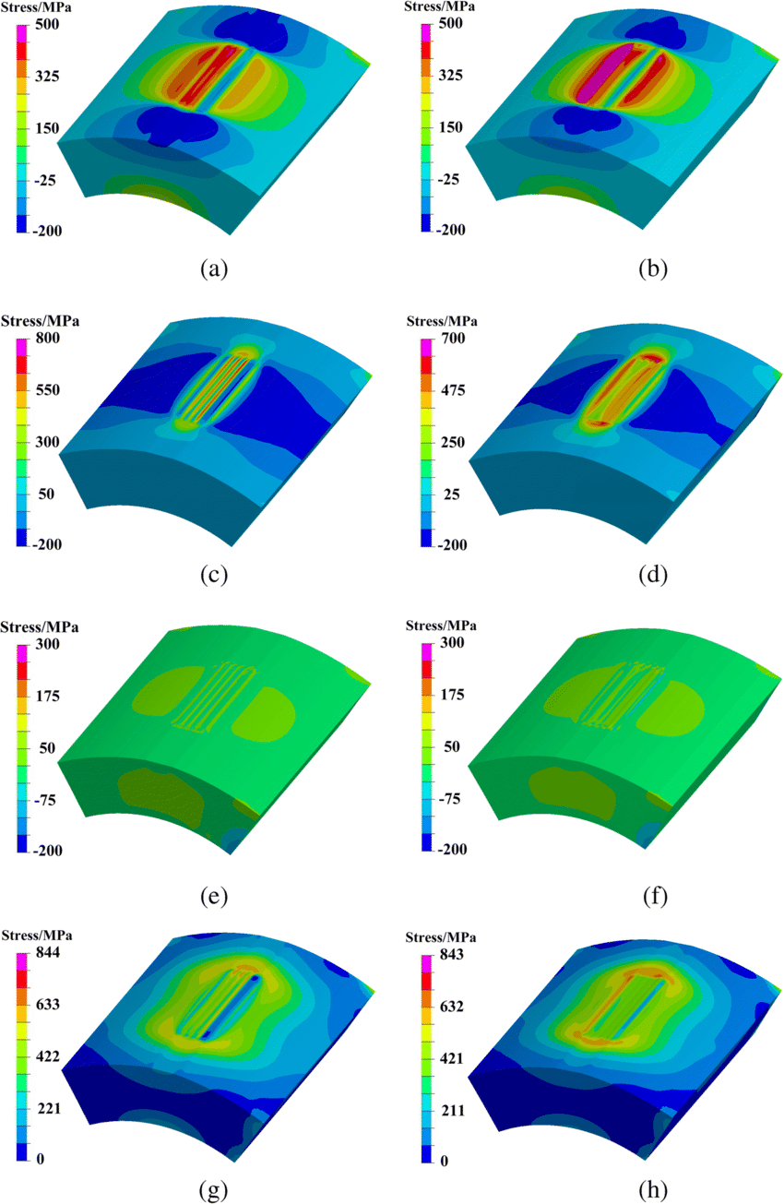
Methods to Mitigate Residual Stresses
Process Parameters for Optimization:
  Temperature
  Pressure
  RF Power
  Gas Mixture
  Deposition Rate
Material selection and layer design
  Stacking material layers with different residuals stresses
  Adjust the stoichiometry of the deposited material
Annealing
  Temperature Profile
Notes:
Ex. Using LPCVD to deposit Silicon Nitride in a ratio of 1 Si : 1.1 N results in almost zero residual stress
LPCVD exhibits low to moderate residual stress depending on temperature
Ex. a tensile-stressed silicon nitride deposited between layers of compressively-stressed polysilicon exhibits very little residual stress
PECVD and PVD Sputtering have easy-to-manipulate parameters

Slide 7
Milestones and Future Plans
Studied the different semiconductor fabrication processes
  Deposition
  Photolithography
  Etching
Conducted a literature study of the residual stress in thin-films
Future plans
  Obtain training in the AggieFab on facilities and processes
  Conduct thin-film deposition experiments
  Characterize the thin-film stress level
  Study the optimization procedures and methods

